Slide 1
Colombia Presentation

Slide 2
Colombia
1940’s –La Violencia
1960’s-formation of Guerilla groups/FARC
1980’s – Production of Cocaine skyrockets
1990’s-early 2000’s –Rise of Paramilitary groups
2016- Peace Accords
Current- fragile peace and unrest

Slide 3
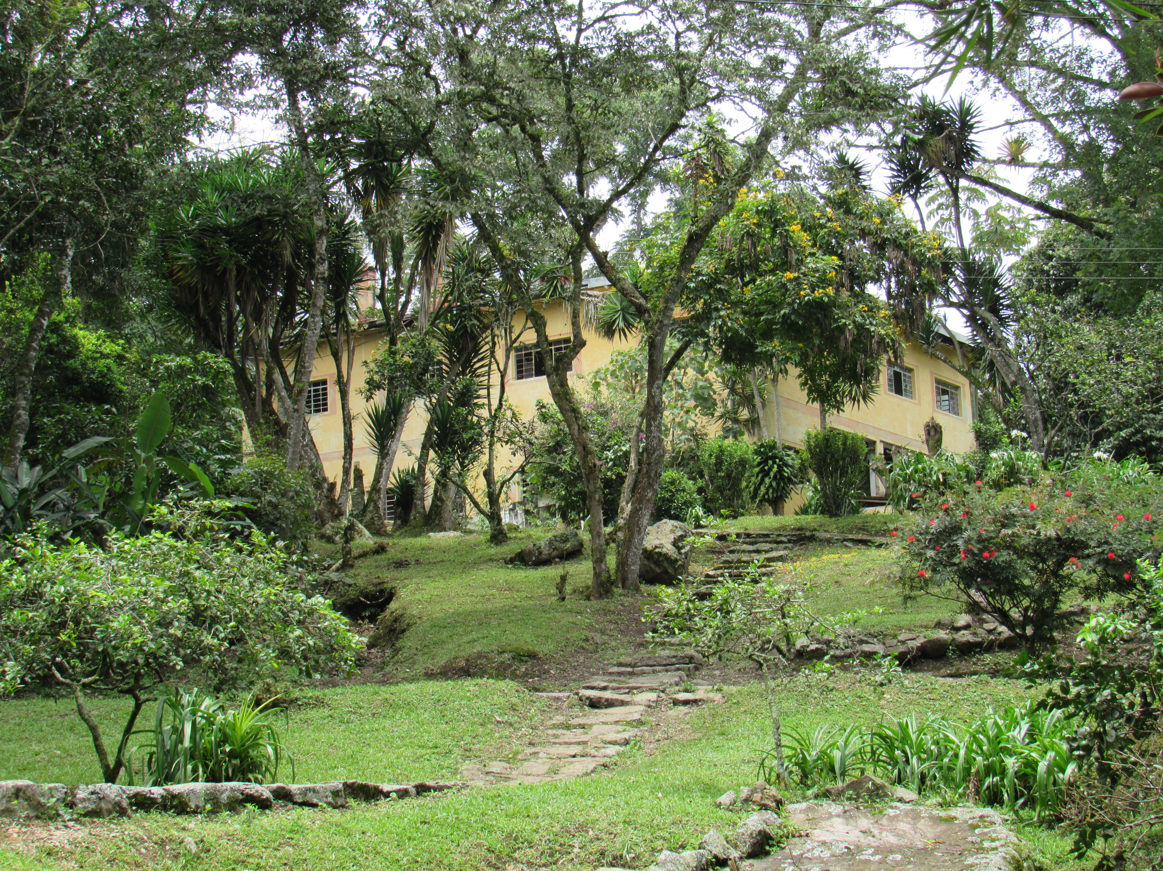
The Mennonite Church in Colombia
-1947: Mennonite Missionaries start boarding school for orphans.
-25+ churches in four regions: Bogotá/Soacha, Occidente, Costa Caribe, and Sabana y Tequendama.
-Small Church, Big Voice
Justapaz, Mencoldes, Puentes para la Paz, Creciendo Juntos, Niños para la paz, Sembrandopaz, etc…

Slide 4
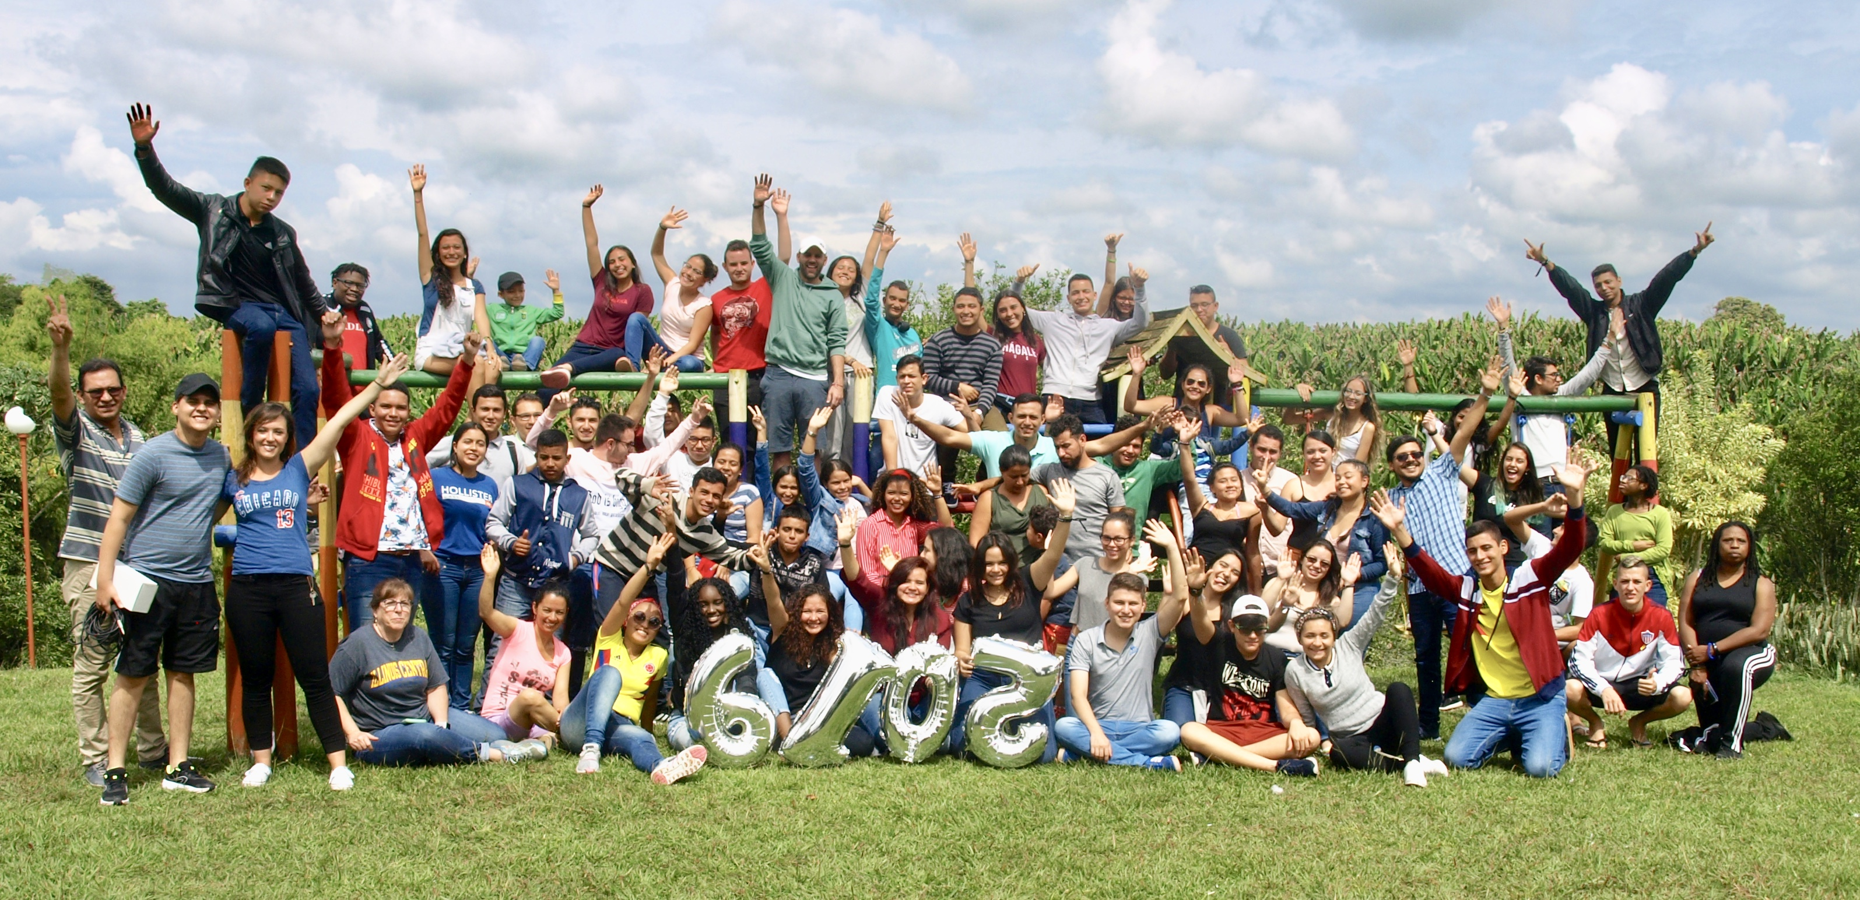
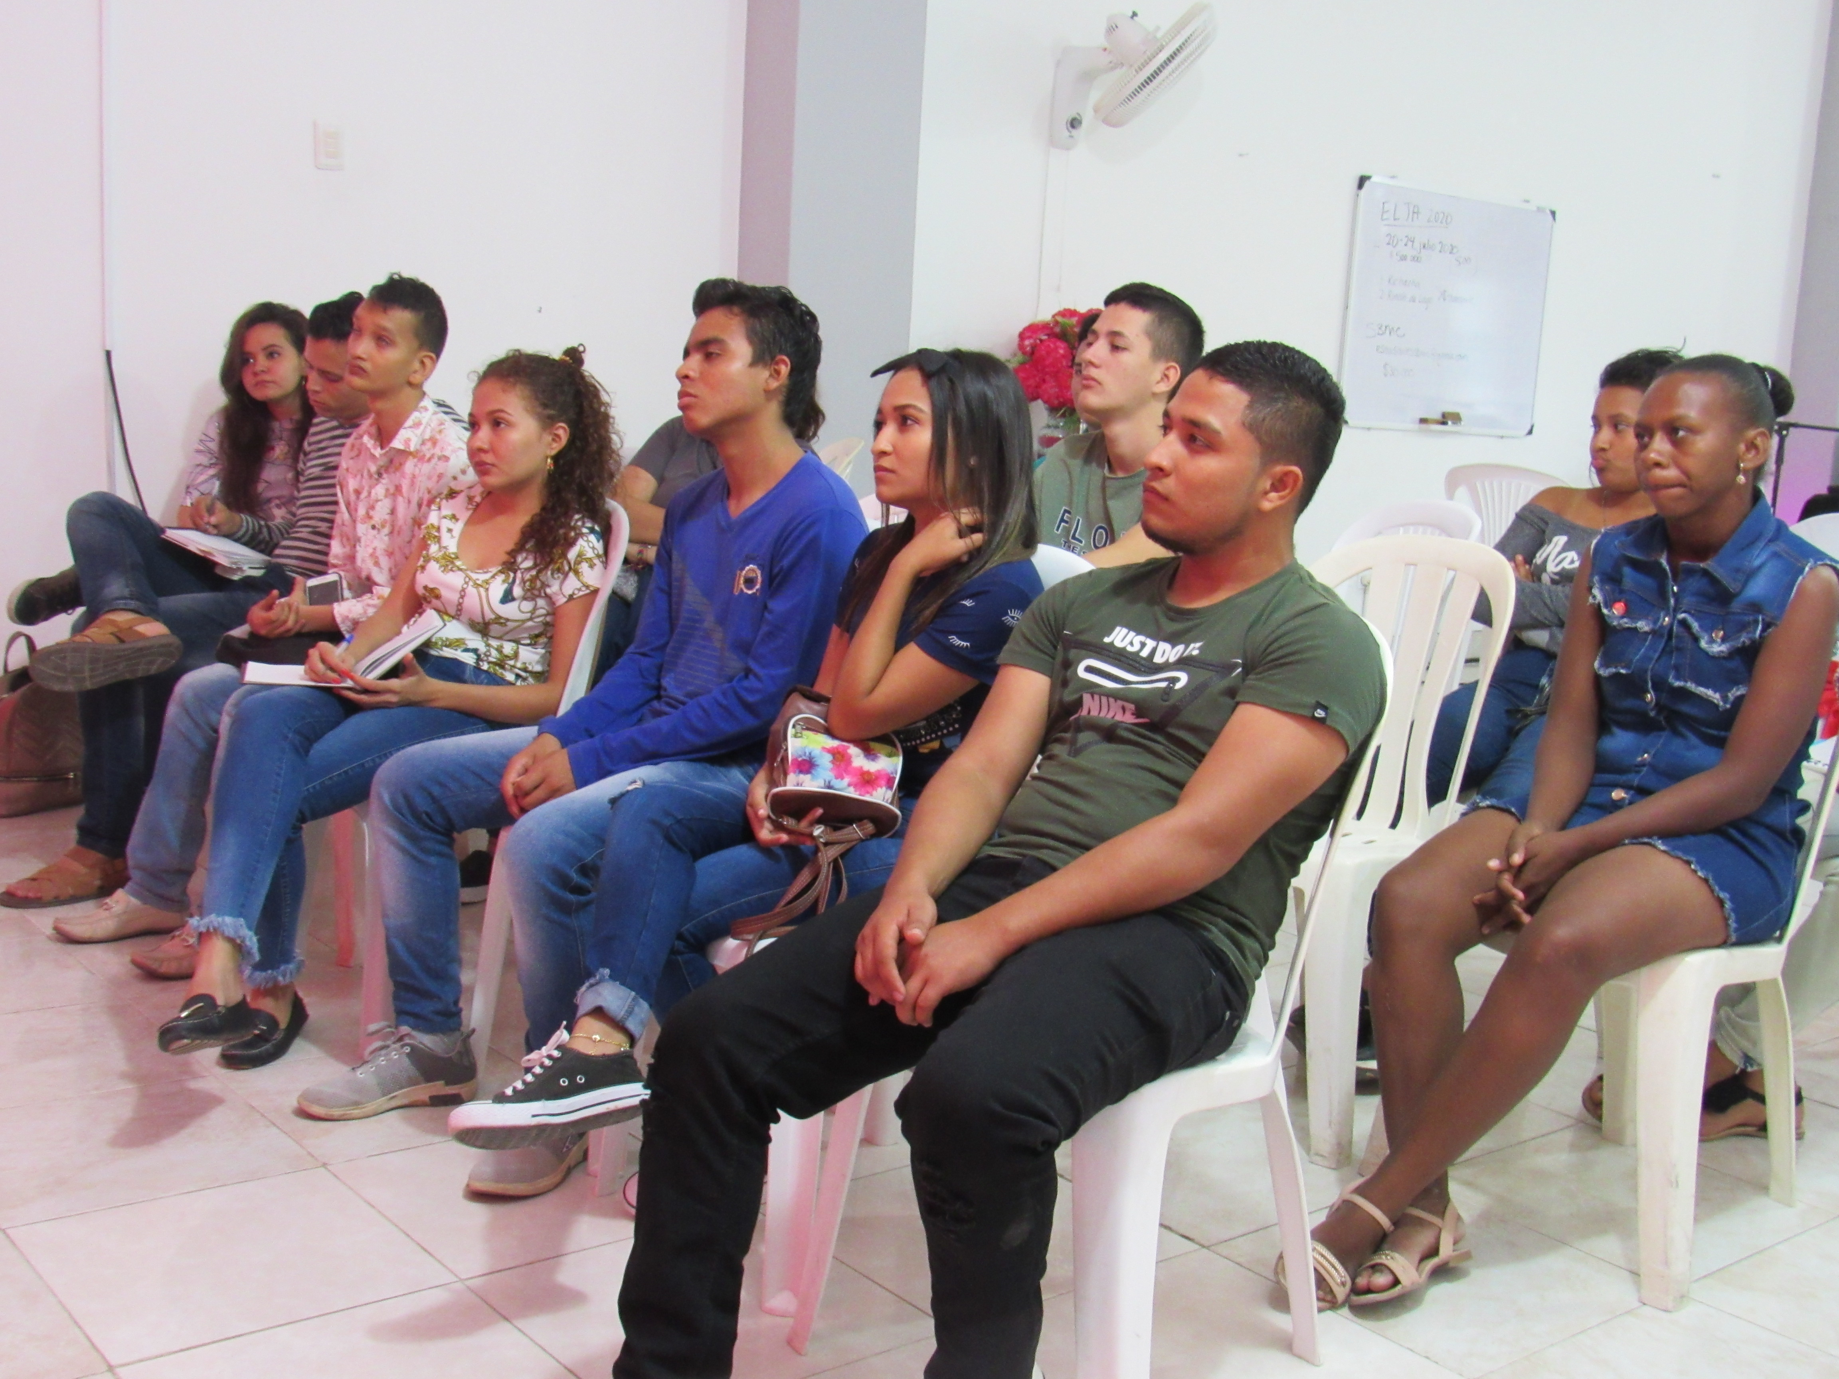
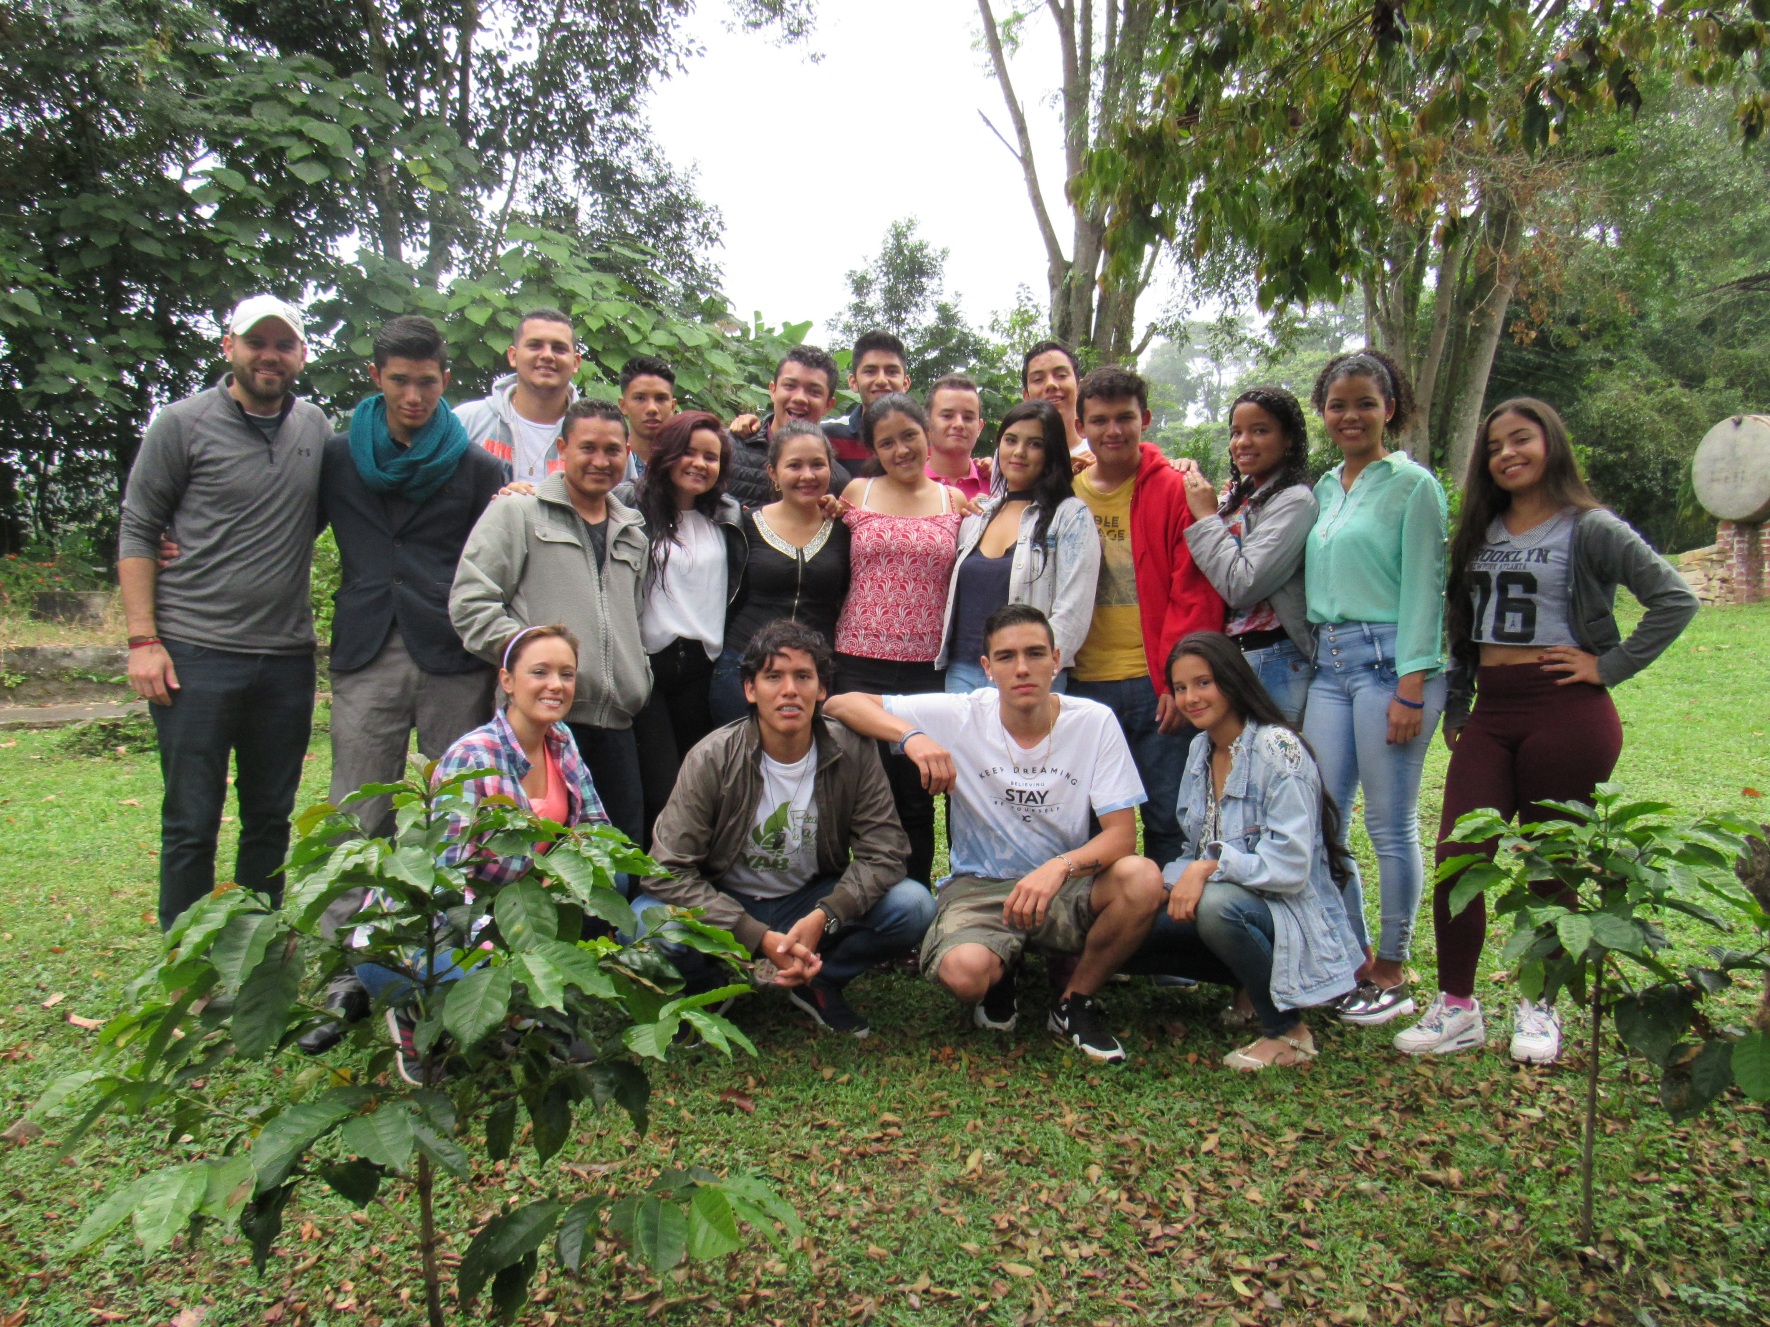
Our Work
National Camps
Workshops
Leadership Development
Online Seminary Program
Planning for future
Relationships

Slide 5
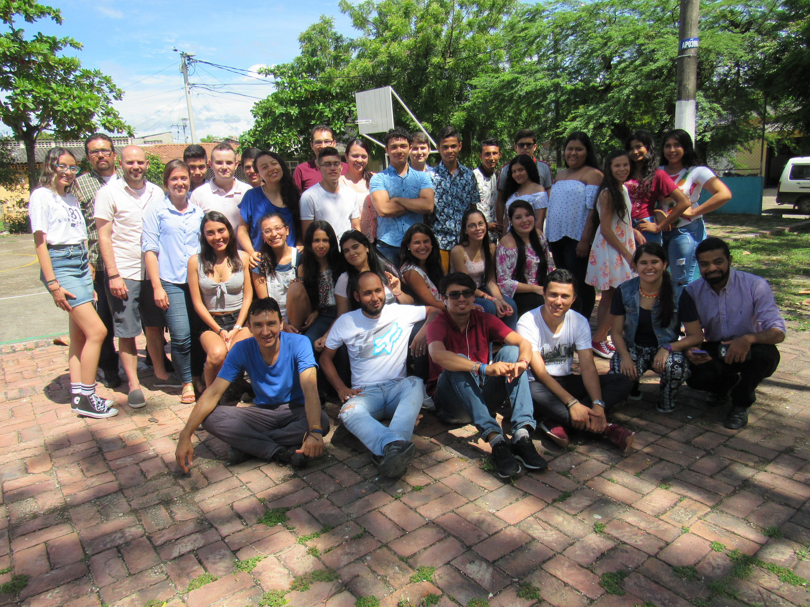
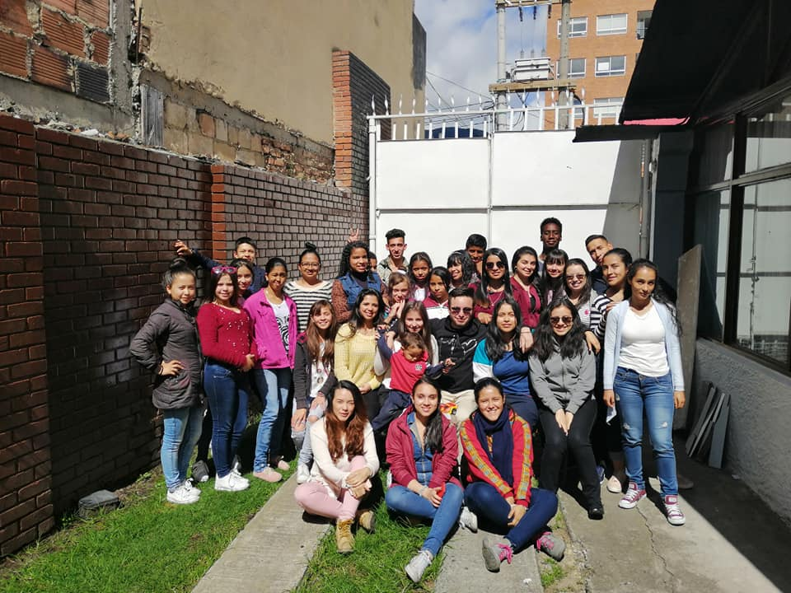
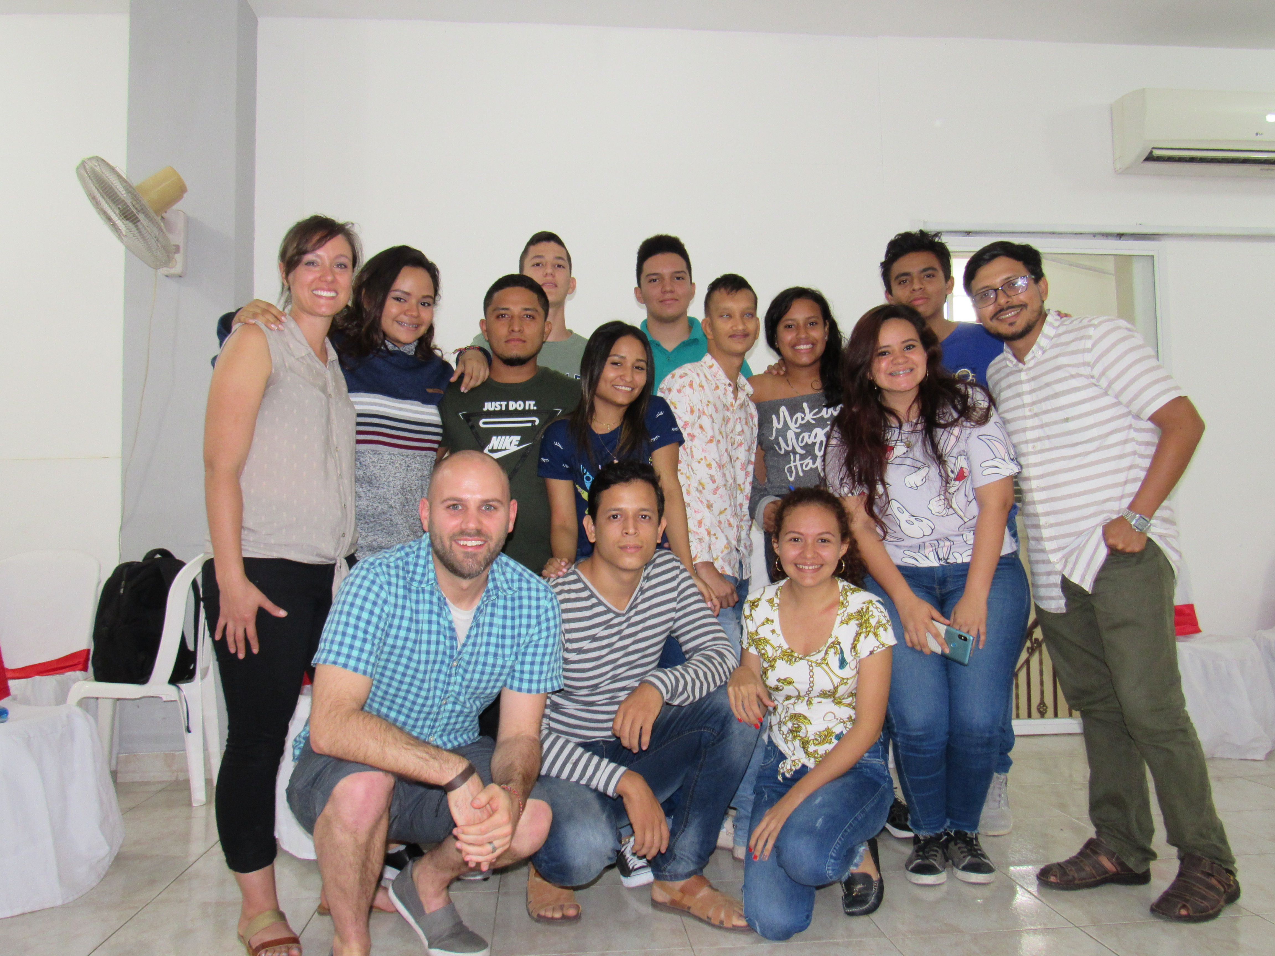
Shalom: A Complete Peace
Justice, Peace, and Non-violence
Colombian Conflict
Conscientious Objection
Systemic injustice
Machismo

Slide 6
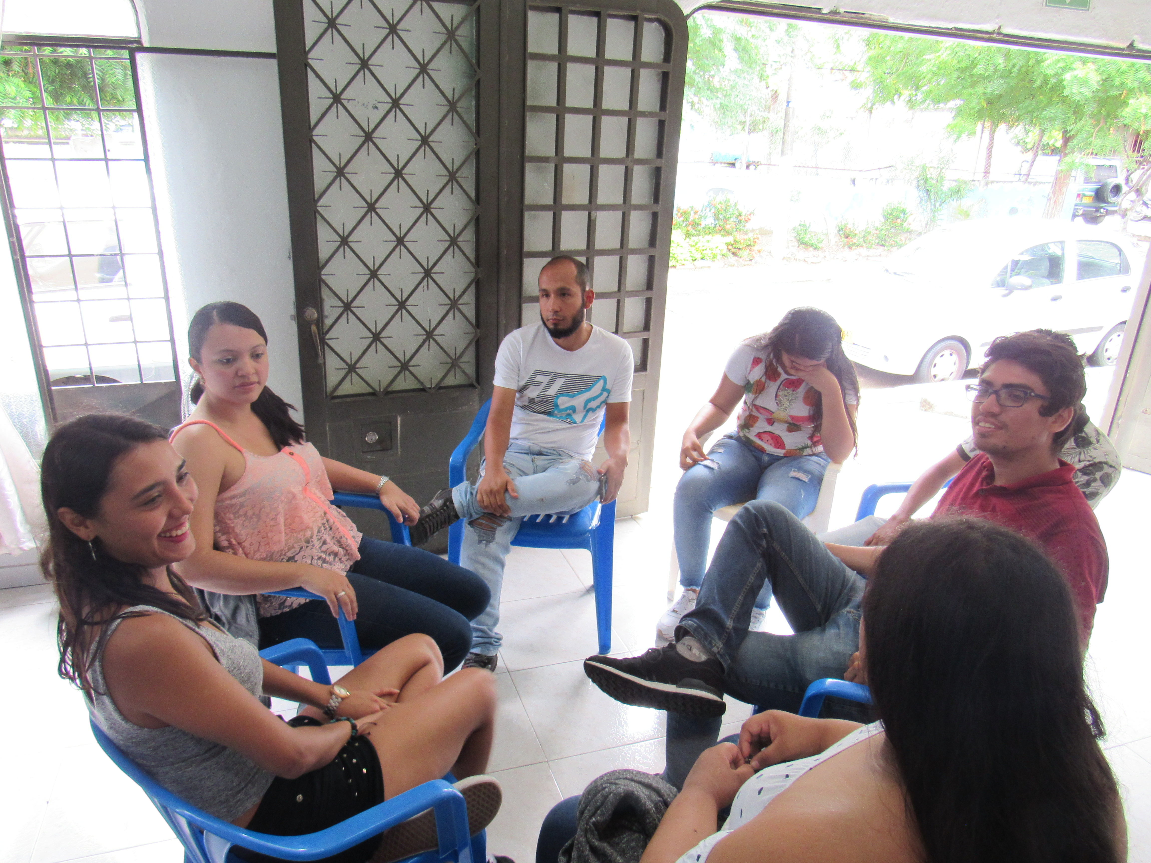
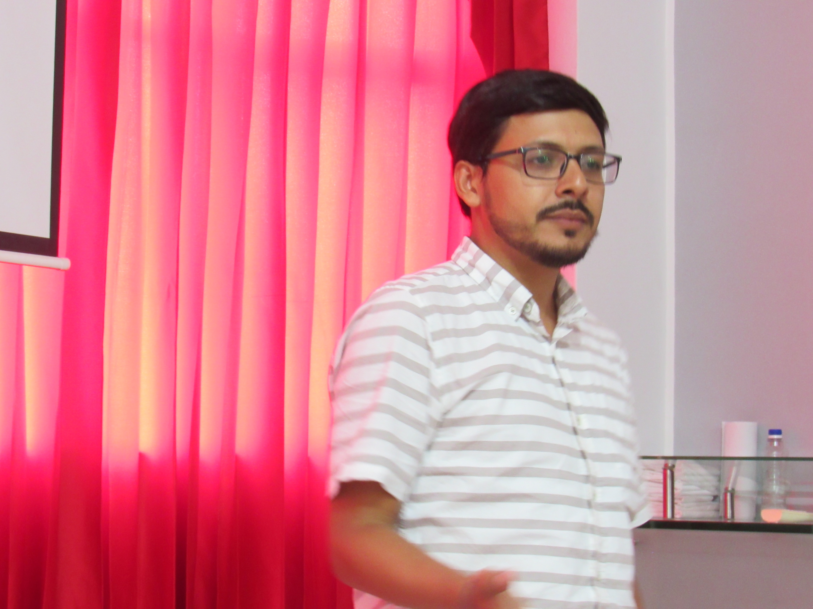
Contextual Reading of the Bible
See
Judge/Analyze
The Text
Our Context
Act

Slide 7
Esther 2:1-18- Seeing
In our own words- What happened in the story?
What are themes that you see in this story?

Slide 8
Esther 2:1-18-Analyzing
Who are the Characters in this story
What does the text say about them?
Who has power in this story?
How is that power used?
What violence do you see happening in the story?
What type of violence?
What institutionalized practices do you see in the story?
Are they harmful?

Slide 9
Esther 2:1-18-Analyzing
Are there characters in our own context like those in the story that exist in our churches? Local communities? Larger context? (national, international, global)
What are the effects of their actions on the community?
Is there violence in our contexts similar to the violence that occurs in the text?
Does there exist practices in our churches or communities that appear natural or institutionalized that are harmful for some and beneficial for others?

Slide 10
Esther 2:1-18-Acting
What subjects does this Bible study bring to mind? How could the community respond to these subjects?
What resources do your church have to help women and men in positions like Esther and the King?
What can be done right now regarding this subject without any resources?
What can be done in the next month with some resources?
What could be done with unlimited resources? (Dream Big)

