Slide 1
Jonás
Que es el punto de ser un Cristiano?

Slide 2
El Libro De Jonás

Slide 3
Tentación # 1: Creemos que somos dueños de Dios

Slide 4
Tentación # 2: Creamos a Dios a nuestra imagen.

Slide 5
Tentación #3: Necesitamos defender a dios

Slide 6
Tentación #4: Desarrollamos un complejo de mártires

Slide 7
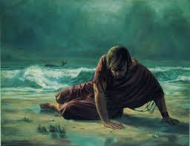
?Que es El punto?

Slide 8
Jonah

Slide 9
?So what is the Point?

Slide 10
The Book of Jonah

Slide 11
Where do we see the story of Jonah in our world?
What themes do we see in the book of Jonah that we can also see in our world?
What troublesome characteristics do we see in the character of Jonah?
Do we see similar characteristics within our own society? Where?

Slide 12
Temptation # 1: We create God in our own image

Slide 13
Temptation # 2: We start to Believe we own God

Slide 14
Temptation #3: We need to defend God

Slide 15
Temptation #4: We develop a Martyr’s complex

Slide 16
?So what is the Point?

